Slide 1
Homework 1 Automatic Lens Smear Detection
Group Members
Daksh Gupta - A20351161
Sandeep Baradi - A20352613
Ashwani Panwar - A20384632
Hatim Dhuliawala - A20351495

Slide 2
Approach
Calculated the Average of Images for each camera separately.
Thresholding the images at 100

Slide 3
Average of all Images for cameras

Slide 4
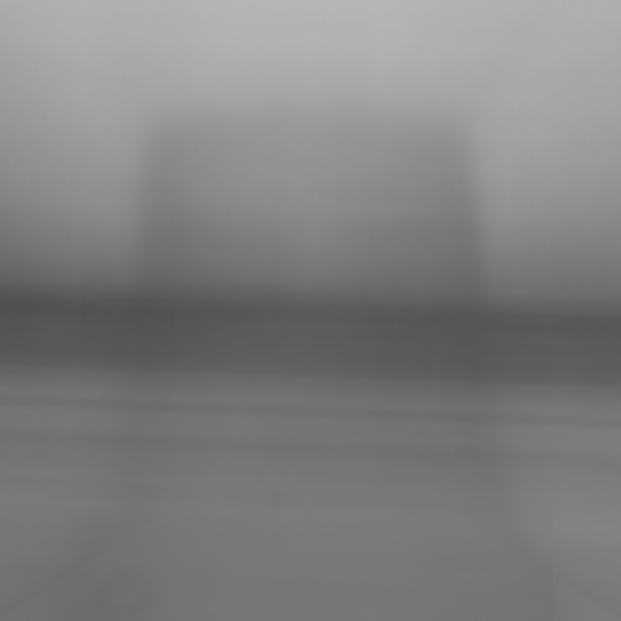
cam_1

Slide 5
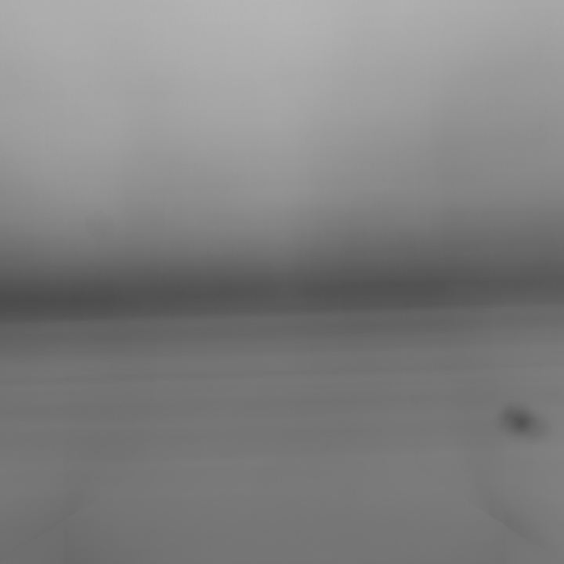
cam_3

Slide 6
Approach cont.
Making an assumption, that the horizontally central part of the image will contain only road patterns, we exclude that part from the mask.
Include everything else in the mask
Dilate the mask using a kernel of 5x5

Slide 7
Intermediate Results and Smear masks

Slide 8
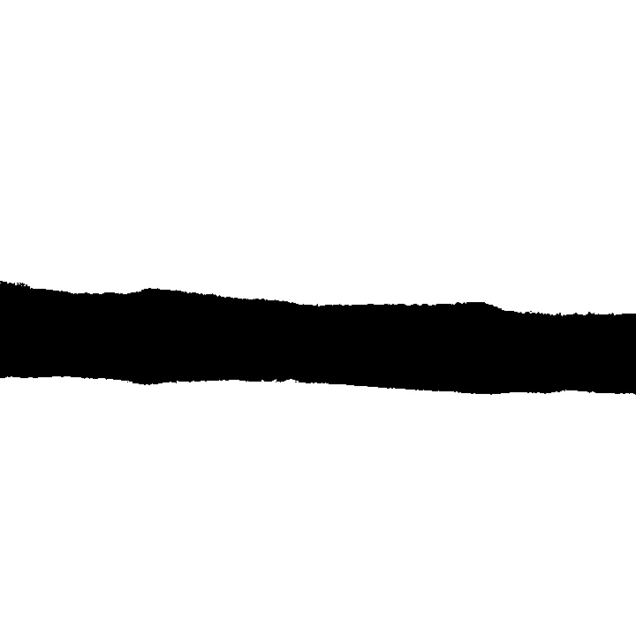
cam_1
Intermediate Result

Slide 9

cam_1
Smear mask

Slide 10

cam_3
Intermediate Result

Slide 11
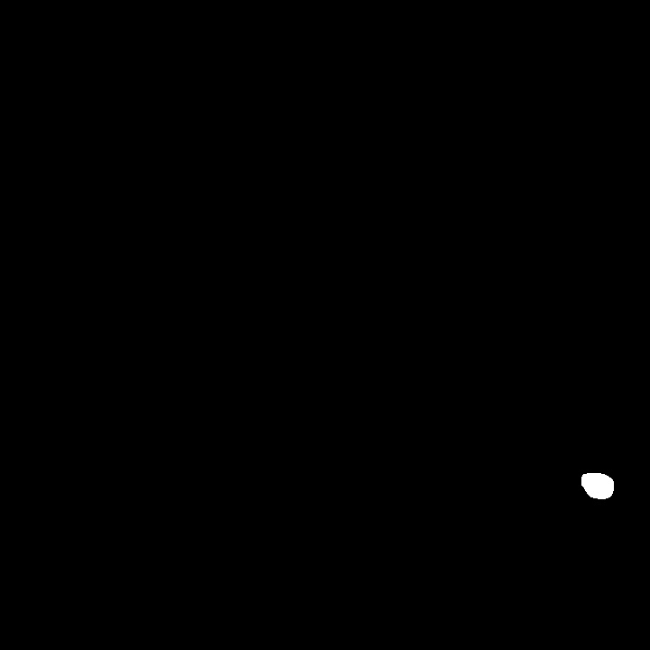
cam_3
Smear mask
The detected smear is highlighted in the image.

Slide 12
Drawback of Approach
The smear will only be detected if it absorbs light, for example dirt on the lens, etc.
The smear will not be detected in the central part of the image.

